Slide 1
God’s Hand in America’s History -Part 2-
America as a Self-Governing Nation

Slide 2
Session 3 Objectives
To identify the cause-effect relationship that gave rise to the American founding generation
To recognize the Biblical principles expressed in the Declaration of Independence and the Constitution of the United States of America.

Slide 3
Recap
Worldview determines how one sees life.
The Providential view of history is what the Bible teaches.
The Hebrew Republic had a greater effect on America’s government and education systems than did Greece or Rome.
The translation of the Bible into the common tongues had a profound effect on the Western Civilization.
The U.S.A. is a product of the Protestant Reformation.

Slide 4
The Pilgrims
A People of the Book
A People of Christian Character
A People Who Loved Liberty
A People Who Were Steppingstones for Posterity
A People Who Laid Down Their Lives for the Glory of God and the Advancement of the Christian Faith
Notes:
In 1843, John Overton Choules wrote in his Preface to a reprinted history book, “ We should never forget that the prison, the scaffold, and the stake were stages in the march of civil and religious liberty which our forefathers had to travel, in order that we might attain our present freedom .… Before our children remove their religious connexions, … before they leave the old paths of God’s Word, … before they barter their birthright for a mess of pottage—let us place in their hands this chronicle of the glorious days of the suffering Churches, and let them know that they are the sons of the men “of whom the world was not worthy,” and whose sufferings for conscience’ sake are here monumentally recorded.
Hall, V. M. (2006). The Christian history of the Constitution of the United States of America. Christian self-government (Founders Edition, Vol. 1, pp. 183–184). San Francisco: Foundation for American Christian Education.

Slide 5
The Mayflower Compact
America’s founding governmental document. It was based on Christian self-government.
“for the glory of God, and advancement of the Christian faith, and honor of our king and country”
“combine ourselves together into a civil body politic…”
“for our better ordering and preservation…”
Notes:
This would be the first experiment in being governed by the people themselves - becoming a seed for what will be known as self-government.
{Note to teachers: Read the writings of John Robinson and parts of Of Plimoth Plantation by Wm Bradford for more details. Have students memorize all or part of this 2 paragraph document.}
The document is only 2 paragraphs long. The 6 basic points of the Mayflower Compact are as follows.
for the glory of God, and advancement of the Christian faith, and honor of our king and country– THEY REMAINED LOYAL TO THE KING AS ENGLISHMEN.
solemnly and mutually in the presence of God, and one another, covenant and combine ourselves together into a civil body politic
for our better ordering and preservation

Slide 6
The Mayflower Compact (cont.)
“frame such just and equal laws…”
“thought most meet and convenient for the general good of the colony…”
“unto which we promise all due submission and obedience.”
Notes:
hereof, to enact, constitute and frame such just and equal laws, ordinances, acts, constitutions and offices – EVERYONE WAS TO BE TREATED EQUALLY UNDER THE LAW.
from time to time, as shall be thought most meet and convenient for the general good of the colony
unto which we promise all due submission and obedience.
To be recorded, The Biblical Principles of the Pilgrims would include:
Trust in the Lord and lean not on your own understanding – Psalm 37:5, Psalm 84: 11-12 & Prov. 3:5. God is spirit, and those who worship Him must worship in spirit and truth – John 4:24
GOVERNMENTAL PRINCIPLES:
OUR HERITAGE OF CHRISTIAN CHARACTER – They encouraged and helped each other throughout the voyage and first winter.
VOLUNTARY CONSENT – They chose to leave home and settle in the New World
PLANTING THE SEED OF SELF-GOVERNMENT – These last 2 are exemplified by the Mayflower Compact which created a government formed by the governed

Slide 7
The Puritans
“For we must consider that we shall be as a city upon a hill. The eyes of all people are upon us. So that if we shall deal falsely with our God in this work we have undertaken, and so cause Him to withdraw His present help from us, we shall be made a story and a by-word through the world.”
John Winthrop (1630)
Notes:
Arbella: A Model of Christian Charity
Half-way Covenant - Approx. 40 years later

Slide 8
The Great Awakening (c. 1730-1750+)
New England: Congregationalists
Middle Colonies: Presbyterians and Catholics
the South and Tidewater: Baptists and Methodists
Some black Baptist churches were founded in VA and both Baptists and Methodists made strong attempts to evangelize free blacks and slaves.
Evangelists: Anglican George Whitefield Congregationalist Jonathan Edwards

Slide 9
The Great Awakening (c. 1730-1750)
All men are created equal
Man’s true value lies in his moral behavior rather than class
All men can be saved.
Liberty of conscience is an inalienable right of every reasoning creature.
The ideas of natural law, inherent (inalienable) freedoms, and self-determination mixed in the colonial Christian denominations was the crux of the “American Enlightenment.”
Notes:
This combined with the Enlightenment played a key role in the development of the democratic mindset of colonial Americans
No one religious sect could unify the 13 colonies against Britain, but… the shared Christian convictions regarding the nature of sin, virtue, and divine Providence did!
No one religious sect could unify the 13 colonies against Britain, but… the shared Christian convictions regarding the nature of sin, virtue, and divine Providence did!

Slide 10
The Great Awakening (c. 1730-1750)
No one religious sect could unify the 13 colonies against Britain, but… the shared Christian convictions regarding the nature of sin, virtue, and divine Providence did!
“Keeping the main things the main thing” among the denominations provided a common “language” and worldview that united the Colonies.
Notes:
This combined with the Enlightenment played a key role in the development of the democratic mindset of colonial Americans

Slide 11
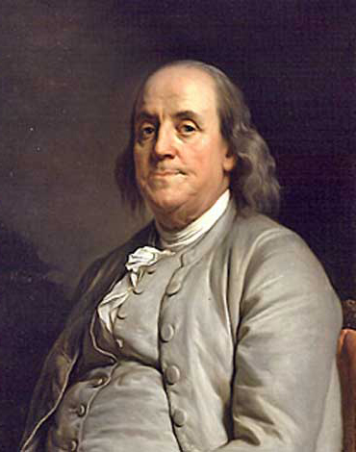
Benjamin Franklin
“…serious religion, under its various
denominations, is not only tolerated, but respected and practiced. Atheism is
unknown there; infidelity rare and secret….
And the divine Being seems to have manifested His approbation of mutual forbearance and kindness with which the different sects treat each other, by the remarkable prosperity with which He has been pleased to favor the whole county.”
Notes:
Franklin, B. (1784). “American Characteristics,” America (Chicago: VFWUS), vol. IV, p. 76

Slide 12
Key Individuals and Events
1600
1700
1800
1620 - Mayflower Compact
1628 - Petition of Rights
1638 – Fundamental Orders of Connecticut
1639 - Massachusetts Body of Liberties
1688 - England’s Glorious Revolution
1689 -Tolerance Act
1689 - English Bill of Rights

Slide 13
Key Individuals and Events
1700
1800
1776 – Declaration of Independence
1789 – U.S. Constitution
1791 – American Bill of Rights

Slide 14
In addition to the Bible…
Who and what
did the Founders study?

Slide 15
Of Civil Government
John Locke (1632-1704) English philosopher/political theorist
Expounded the idea of Natural Law
Natural rights of the individual Limitations on Parliament
“Taxation without Representation”
“As men we have God for our King, and are under the Law of Reason: as Christians, we have Jesus the Messiah for our King, and are under the Law reveal’d by him in the Gospel.”
From “The Reasonableness of Christianity”, 1695.
Notes:
Biographical entries from the Christian history library. (2007). San Francisco: Foundation for American Christian Education.

Slide 16
The Spirit of Laws
Charles Montesquieu (1689-1755) French political philosopher
Identified three historical forms of government, with their animating principles: the republic, based on virtue; the monarchy, based on honor; and despotism, based on fear.
Expounded the theory of Separation of Powers:
Legislative, Executive, Judicial

Slide 17
Commentaries (1765)
William Blackstone (1723-1780) English jurist of renown
Law of Nature (LoN) – Order of Creation as the Will of God
Law of Scripture – Revelation for man’s understanding of LoN
Natural Law – Man’s distorted understanding of Law of Nature
Human Law – Man’s practical application LoN: “Common Law”
Blackstone distinguished between three types of civil governments: Democracy, Aristocracy, Monarchy

Slide 18
Back to the question:
Who and what did the Founders study?
The people who were the primary influencers of the Founding Generation reasoned and wrote from a Biblical Christian basis.
Notes:
Not from the basis of the “Humanistic Enlightenment”

Slide 19
Classical Approach
Material Cause - the physical elements
Efficient Cause - how it was going to get done
Form(al) Cause - the form or structure to contain it
“Love of” Cause - the vision, the heart, the inspiration

Slide 20
Four Main Causes of the United States of America
“Material” Cause – the Land (a continent) and the People (they were builders)
“Efficient” Cause – the Founders
“Form(al)” Cause – the Constitution itself
“Love of” Cause - the principles in the Declaration of Independence, which came from God
Notes:
Typical Pattern of Classical Reasoning:
Material - the physical elements
Efficient - how it was going to get done
Form(al( - the form or structure to contain it
Love of - the vision, the heart, the inspiration

Slide 21
Declaration of Independence The Purpose, Heart, and Cause of the War for Independence
Abraham Lincoln described the relationship between the Declaration and the Constitution to be like that of a picture of an “apple of gold” within a “silver frame.” (The U.S. Constitution: A Reader , Hillsdale College Press, 2016)
Lincoln also called it “a rebuke and a stumbling block to tyranny and oppression.” https://www.archives.gov/founding-docs/declaration

Slide 22
Declaration of Independence
“Prudence indeed, will dictate that governments long established should not be changed for light and transient causes…. But when a long train of abuses and usurpations, pursuing invariably the same Object evinces a design to reduce them under absolute Despotism, it is their right, it is their duty, to throw off such Government, and to provide new Guards for their future security.”

Slide 23
27 Grievances Against the King
He has refused his Assent to Laws…necessary for the public good. | He has erected a multitude of New Offices, and sent hither swarms of Officers to harrass our people, and eat out their substance.
He has dissolved Representative Houses repeatedly | He has kept among us, in times of peace, Standing Armies without the Consent of our legislatures
He has refused for a long time…to cause others to be elected… The State remaining in the mean time exposed to all the dangers of invasion from without, and convulsions within. | For Quartering large bodies of armed troops among us…. For protecting them, by a mock Trial, from punishment for any Murders which they should commit
He has obstructed the Administration of Justice…. He has made Judges dependent on his Will alone… | For imposing Taxes on us without our Consent…For depriving us in many cases, of the benefits of Trial by Jury…

Slide 24
Declaration of Independence
“In every stage of these Oppressions We have Petitioned for Redress in the most humble terms: Our repeated Petitions have been answered only by repeated injury….
A Prince whose character is thus marked by every act which may define a Tyrant, is unfit to be the ruler of a free people.”

Slide 25
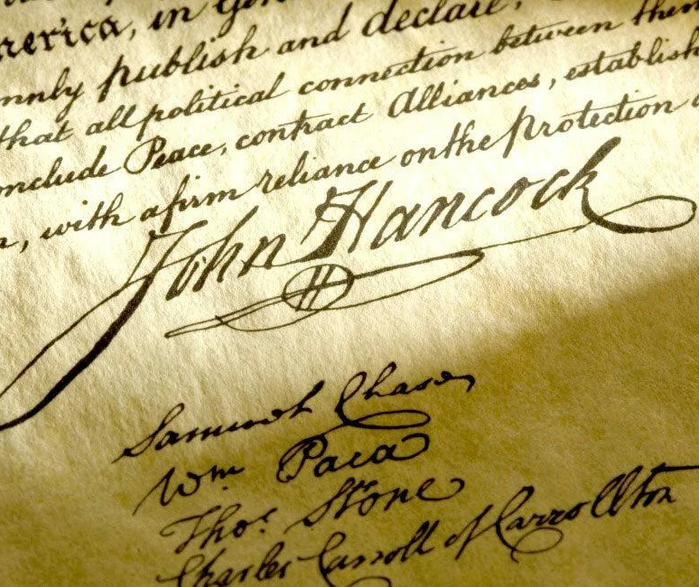
What Next?
“And for the support of this declaration, with a firm reliance on the protection of Divine Providence, we mutually pledge to each other our lives, our fortunes, and our sacred honor.”

Slide 26
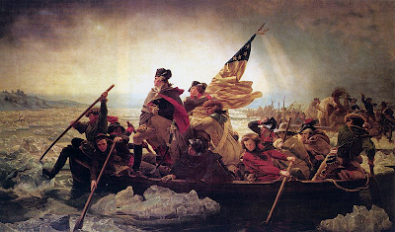
Was There Biblical Justification for American Independence?

Slide 27
TYRANT, n.
A monarch or other ruler or master, who uses power to oppress his subjects; a person who exercises unlawful authority, or lawful authority in an unlawful manner; one who by taxation, injustice or cruel punishment, or the demand of unreasonable services, imposes burdens and hardships on those under his control, which law and humanity do not authorize, or which the purposes of government do not require. (Webster, 1828)

Slide 28
Christ’s Guidelines for Resistance to Tyranny
America’s Providential History, Beliles and McDowell, 1989
Protest or Legal Action
Mt. 27:14 (to Pilate)
Lk. 13:31-32 (re: Herod)
Lk. 10:11 (public protest)
Acts 16:37 (Paul and Barnabas)
Acts 24-26 (Appeal to Caesar)

Slide 29
Christ’s Guidelines for Resistance to Tyranny
America’s Providential History, Beliles and McDowell, 1989
2. Flight
Mt. 10:23 (flee to next city)
Mt. 24:15-18 (flee coming destruction)
Acts 8:1-4 (flee persecution)

Slide 30
Christ’s Guidelines for Resistance to Tyranny
America’s Providential History, Beliles and McDowell, 1989
Force in Self-defense
Lk. 22:36, 38; Mt. 26:52
(force legitimate at some times,
such as retrain the illegal sword
of an aggressor )
“A lower representative must be convinced to ignore a higher decree in obedience to God’s higher law.”

Slide 31
1783 – Treaty of Paris
Notes:
https://images.slideplayer.com/26/8506790/slides/slide_2.jpg

Slide 32
The Constitution of the United States of America 245 years and counting…
Article | Purpose
I | Establish the Legislative Branch, with Two Houses (Chambers).
II | Establish the Executive Branch, with President and Vice Pres.
III | Established the Judicial Branch, with the Supreme Court.
IV | Establishes how States interact with each other re: their laws.
V | Explains the Amendment process for making/changing the Constitution.
VI | Federal law is supreme, overriding State laws, when in conflict.
VII | Describes the ratification process for the Constitution.

Slide 33
The Christian Form of our Government [Isaiah 33:11; II Cor. 3:17]
Three COEQUAL BRANCHES bringing SEPARATION OF POWERS thus bringing CHECKS AND BALANCES to bear. Why?
LEGISLATIVE – elected by the people House of Representatives and Senate, makes the laws)
EXECUTIVE – elected by the people, enforces the laws
JUDICIAL – appointed by the executive, confirmed by senate

Slide 34
The United States of America: Identity Crisis?
Democracy - Government by the people; a form of government, in which the supreme power is lodged in the hands of the people collectively, or in which the people exercise the powers of legislation. Such was the government of Athens.
Republic - A commonwealth; a state in which the exercise of the sovereign power is lodged in representatives elected by the people. In modern usage, it differs from a democracy or democratic state, in which the people exercise the powers of sovereignty in person. Yet the democracies of Greece are often called republics.

Slide 35
Federalism and Our Dual Form of Gov’t
A. Federalism - consisting in a compact between parties, particularly and chiefly between states or nations; founded on alliance by contract or mutual agreement.
B. Dual Form of Government -
relating horizontally
and vertically with different parties,
based upon authority structure
Matthew 22:37-39

Slide 36
America’s Founding Documents: Revolutionary or Conservative?
Both
Notes:
Again, from Dr. Larry Arnn

Slide 37
Next Week
Can America become a self-governing nation once again
?
Two primary requirements…

