Slide 1
Vitally Important Information on HR1/SB1
Wednesday, March 31 at 10:00 a.m. – Senate hearings on SB1
For information/perspective see:
https://www.youtube.com/watch?v=pCQvO6PRKSg&t=18s (begin at 3 minutes and continue through pray to ~ 60 min. (World Prayer Network)
https://www.regent.edu/misc/analyzing-american-election-integrity/. Go to Part 2, which deal directly with HR 1 and how it will totally transform America through election laws.

Slide 2
Principle Approach Education
“Gospel Key to America’s Future as a Blessed Nation”

Slide 3
We don’t confuse our nation with the Kingdom of God, but we see our nation as a great gift of God to the world in presenting the liberty which is manifested, internally and externally, through Jesus Christ.

Slide 4
John Adams, Founder and 2nd US President
“Suppose a nation in some distant region should take the Bible for their own law book, and every member should regulate his conduct by the precepts there contained! Every member would be obliged in conscience to temperance, frugality and industry; to justice, kindness and charity towards his fellow men; and to piety, love and reverence toward Almighty God.”
Blessed is the nation whose God is the Lord. (Psalm 33:12)
Notes:
Charles Francis Adams, ed., The Works of John Adams--Second President of the United States (Boston: Little, Brown and Company, 1856), Vol. II, p. 6.

Slide 5
Rev. Jedidiah Morse (Pastor and Educator)
“On the early and proper education of children depend, in a great measure, their own happiness, that of their parents, their country, and posterity. The continuance and security of true Religion, and of civil liberty, among any people, must result from their being enlightened by true and useful knowledge. The foundation of this knowledge is laid in Schools and Families, where its rudiments are, or should be taught.” (1795)
Slater, R. J., & Hall, V. M. (1975). Teaching and learning America’s Christian history., p. 246). San Francisco: FACE

Slide 6
Noah Webster wrote:
“The Education of youth, an employment of more consequence than making laws and preaching the gospel, because it lays the foundation on which both law and gospel rest for success…”
On the EDUCATION of YOUTH in AMERICA
New Work, 1788

Slide 7
With last week’s introduction in Congress of the misleadingly named Civics Secures Democracy Act, we are headed toward an epic clash over the spread of uber-controversial pedagogies — Critical Race Theory and Action Civics — to America’s classrooms. I don’t know whether the country will wake up to the danger of this legislation before or after it passes. Sooner or later, however, the truth will out. When it does, the culture war will have merged with K–12 education-policy disputes to a degree never before seen…
“The upshot is that the lion’s share of this billion-dollar jackpot will support mandatory leftist protest, lobbying, and indoctrination, while supporters of traditional civics and history will be frozen out….” (National Review, 3/15/21)

Slide 8
Watch out!
https://www.nationalreview.com/corner/the-greatest-education-battle-of-our-lifetimes/.
Wikipedia:
Project 1619
Project 1776
 | This article relies too much on references to primary sources. Please improve this by adding secondary or tertiary sources. (April 2017) (Learn how and when to remove this template message)

Slide 9
T
H
I
N
K
I
N
G
G O V E R N M E N T A L L Y

Slide 10
Biblical Christian View
View of God Cause | View of Man | View of Education | View of Gov’ Effect
The One, the Only, the Perfect, the Creator, Infinite, Holy, Wise, Love, Savior, and on and on… | Imago Deo Sinful by Nature, fallen In need of a Savior Capable of being “born again) Immortal being | God-Honoring Christ-Centered Holy Spirit-Inspired Know God Glorify God Good Works | Praise the good, Punish evil-doers, Protect God-given rights of individuals (i.e., LIMITED) Maximize liberty

Slide 11
What is America’s Present Condition?
View of God Cause | View of Man | View of Education | View of Gov’ Effect
Pluralistic/ Relativistic No absolute truth God made in the image of man Self is god | Evolutionary Higher form of animal life, Homo sapiens Survival of the fittest Death-oriented | Pavlovian Stimulus-Response Regurgitation Standardized Centralized Utilitarian | Expansive/ Intrusive Judicial decree Socialistic Centralized Supreme authority (control)

Slide 12
History of Education in the United States of America
A philosophy of education becomes a philosophy of government!

Slide 13
History of Education in the USA
American Biblical Christian
Approach
1620-1830
(*being restored)
Noah Webster
Father of American Christian Education and Scholarship
Notes:
Read a few excerpts from Webster’s life and philosophy (See T&L and 1828 Dictionary)

Slide 14
History of Education in America
American Christian Approach
Defined: “Education comprehends all that series of instruction and discipline which is intended to enlighten the understanding, correct the temper, and form the habits and manners of youth, and fit them for usefulness in their future stations …”
Noah Webster, 1828
Founding Father of American Christian Scholarship and Education

Slide 15
Biblical Christian Approach
Philosophy/ Worldview | Biblical (II Timothy 3:16-17)
Foundation | Biblical principles of every field of endeavor, and a Biblical childhood and youth (II Timothy 3:14-15)
Key Doctrine | Love of God and Neighbor (NT Commandments 1 & 2)
Character | Christ-centered

Slide 16
History of Education in America
Socialistic
Approach
1830-1930
Horace Mann
Father of the Common School
Notes:
Find a quote of Mann’s

Slide 17
History of Education in America
Socialistic Approach
Defined: “Education, then beyond all other devises of human origin, is the great equalizer of the conditions of men – the balance-wheel of the social machinery.”
“ …that they (‘the evil’) may become good … that injustice may depart … and be known no more.”
Horace Mann
(Twelfth Annual Report, Mass. State School, 1848)
Notes:
Mann placed education (secular) in the place of God (Bible).

Slide 18
Socialistic Approach
Philosophy/ Worldview | Unitarian
Foundation | Social good or morality
Key Doctrine | Love of Neighbor only (NT Commandment #2)
Character | Group-centered Dependency and support of socialism. Humanitarianism
Notes:
What is Unitarian? (Look up!)
What is humanitarianism? Is it a Biblical philosophy? (Look up)

Slide 19
History of Education in America
Progressive (Evolutionary)
Approach
1930-present
John Dewey
Father of Progressive Education
Notes:
Find a quote of Dewey’s

Slide 20
History of Education in America
Philosophy | Evolutionary Ever changing toward perfection
Foundation | Behavioral Psychology and Child Development Theories.
Key Doctrine | Love of Self (Narcissism (I Timothy 3:2)
Character Outcome | Self-centered Lawlessness in support of revolt (anarchy) Humanistic (man is god) Secularism

Slide 21
Postmodern Worldview
Coined by French philosopher Lyotard in 1979
The natural offspring of a progressive, secular philosophy
Moves beyond the Modern view of truth being established by science and reason
There are no boundaries; liberty without law
There are no footholds on reality
The end thereof is hopelessness and death

Slide 22
The Cause to Effect Relationship of Education to Government
Educational Approach
American Christian – “The Principle Approach”
Unitarian – The good-ness of man is deprived not depraved!
Evolutionary – Change producing perfection
Governmental Form
Republican – American Christian Constitutional Federal Republic
Monarchy – Socialism; communism
Democracy – Mob rule, anarchy
Notes:
Republicanism requires responsibility
Monarchy and Socialism depend on a mothering approach.
Democracy allows for manipulation of the herd.

Slide 23
The Principle Approach
America’s historic, Christian method of education that lays Christ as the foundation of every subject, teaching students how to reason from Biblical principles in every subject and then apply them to every area of life.
“For from Him and through Him and to Him are all things. To Him be the glory forever. Amen.” (Romans 11:36)
“For by Him all things we created…. And He is before all things, and in Him all things hold together.” (Colossians 1:16-17)

Slide 24
God’s Word is the Foundation
All Scripture is inspired by God and profitable for teaching, for reproof, for correction, for training in righteousness; so that the man of God may be adequate, equipped for every good work.
II Timothy 3:16-17

Slide 25
What Is Education?
“Education comprehends all that series of instruction and discipline which is intended to
Enlighten the understanding
Correct the temper
Form the manners and habits of youth
Fit them for usefulness in their future stations.
Notes:
Open the dictionary.

Slide 26
A Biblically-Based Definition?
Enlighten the understanding (John 10:37)
Correct the temper (2 Pet 1:4)
Form the manners and habits of youth (Phil 1:11)
Fit them for usefulness in their future stations (John 15:16)

Slide 27
Webster’s Definition Is Biblical
All Scripture is inspired by God and profitable
for teaching,
for correction,
for training in righteousness;
so that the man of God may be adequate, equipped for every good work.
I Timothy 3:16-17

Slide 28
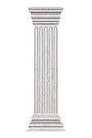
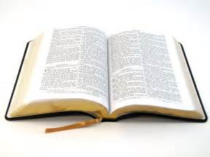
Key Pillars of Principle Approach
I. The Bible, the Word of God,
informs every subject
and every area of Life.

Slide 29
God’s Word in Psalm 119 +
Instructs | References
Our Mind/ Understanding | Psalm 119:169 (Duet. 5:4-7; Rom. 12:2)
Our Mouth/ Speech | Psalm 119:171-172 (Eccl. 5:5-7; Col. 4:6)
Our Will/ Choices | Psalm 119:173 (Ps. 25:12; James 4:7)
Our Emotions/ Desires | Psalm 119:174-175 (Eccl. 11:9;Ps. 37:4; Col. 4:2)
Our Conscience | Psalm 119:176 (Rom. 2:15; 9:1; Heb. 4:12)

Slide 30
More Key Principle Approach Pillars
Biblical Reasoning | Based on sound hermeneutics and logic
Thinking Governmentally | Cause to effect; who or what is control?
Christian Character Development | Internal precedes external; Holy Spirit empowered sanctification process
Providential View of History | Christ, His Story among men and nations. Sovereignty of God.
Classical Studies | That which is noble, excellent, time-tested
Notebook Method (4Rs) | Research, Reason, Relate, Record Use of primary sources
Influential Expression | Words are credible and inspiring

Slide 31
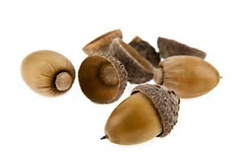
Teaching and Learning by Biblical Principles
Principles are “seeds” that contain all the rudimentary information needed in a given subject to be able to lay a foundation for sound analysis, true understanding, and mastery.
Principles are like trees with the roots being the principles, the trunk and branches being leading ideas, and the fruit being concepts or applications of the subject-principles in the real world.

Slide 32
Critical Thinking Skills are Developed
Principles can be deduced (beginning with the big idea and reasoning to toward the details).
Principles can be induced by beginning with the details and reasoning toward a more comprehensive truth.
Application = Applying knowledge with understanding to bring wisdom (Proverbs 2:6)

Slide 33
What Biblical Principles Do
Biblical principles provide a picture of God’s character and nature.
Biblical principles govern the universe, both natural and spiritual.
Biblical principles provide wisdom for building godly relationships.
Biblical principles provide wisdom for living a fulfilling life.

Slide 34
What Biblical Principles Do Not Do
Biblical principles do not provide content material in a given subject, but function as governing forces that guide the learner along a path of biblical reasoning that results in godly wisdom.
Biblical principles alone do not save you or change your heart, even if you live by them.
What other misconceptions might there be regarding the use/value of Biblical principles/Biblical worldview?

Slide 35
Key Principles Emphasized Through the Grades
Grade | Biblical Principle(s) of Government Highlighted
K | God’s Principle of Individuality; Christian Self-Government
1 | Property: Conscience Is Our Most Sacred Property
2 | Principle of Christian Self-Government
3 | Principle of Christian Character
4 | The Christian Form of Civil Government
5 | The Love Mandate (God, Others)
6 | The Principle of Union with Unity
7 | The Principle of Cause to Effect (Sowing and Reaping)
8 | The Principle of Internal to External; Local Self-Government
9 | The Principle of Providence: Christ, His Story
10-12 | Analyzing the Interactions between the 7 Principles of Gov’t

Slide 36
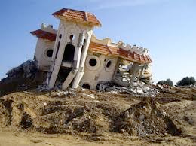
If the foundations are destroyed…
Psalm 11:3
What can the righteous do?”
Notes:
Psalm 11:3

Slide 37
Dayspring’s Principle Approach Mission
To partner with parents and churches to equip students to
Acknowledge the Lordship of Jesus Christ in every area of life
Demonstrate a Biblical worldview
Become citizens of excellence in Christian character and scholarship
Restore America to its Biblical foundation

Slide 38
The PEERS Test
Nehemiah Institute
1988

Slide 39
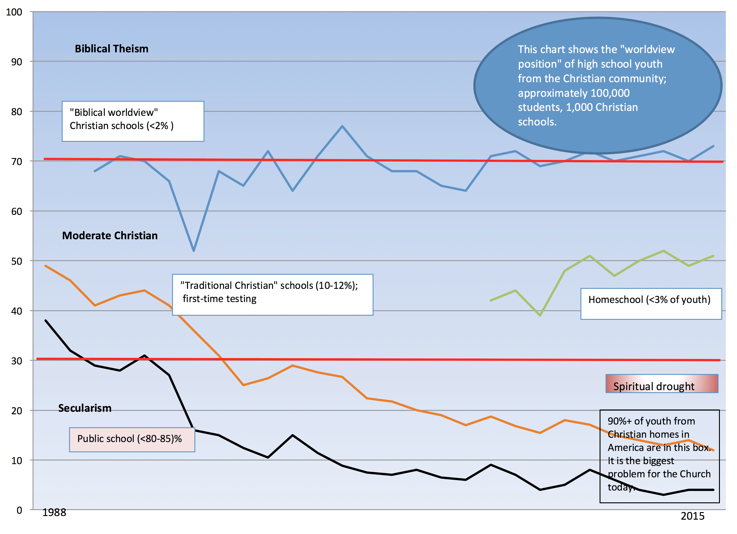

Slide 40
The Foundations of America
“Let divines and philosophers, statesmen and patriots, unite their endeavors to renovate the age, by impressing the minds of men with the importance of educating their little boys and girls, of inculcating in the minds of youth the fear and love of the Deity and universal philanthropy, and, in subordination to these great principles, the love of their country; of instructing them in the art of self-government, without which they never can act a wise part in the government of societies, great or small; in short of leading them in the study and practice of the exalted virtues of the Christian system.”
Samuel Adams, Father of the American Revolution

Slide 41
Restoring the Foundations of America
Let pastors and philosophers, statesmen and patriots, unite their endeavors to repair and restore our age, by impressing the minds of parents with the importance of educating their little boys and girls, of inculcating in the minds of youth the fear and love of God and loving people everywhere, and, in subordination to these great principles, the love of their country; of instructing them in the art of self-government, without which they never can act a wise part in the government of societies, great or small; in short of leading them in the study and practice of the exalted Gospel of Jesus Christ and His eternal Kingdom.”

